Slide 1
Seattle SafeCycle
Abel,William,Dylan,sebastian

Slide 2
How can we determine which bike rack is safe from thefts or not?
Our solution: A tool that allows bike riders to find the best parking space nearby for their bike.

Slide 3
Data & Focus Area
Data :
Seattle Department of Transportation bike thefts
Seattle Department of Transportation bike racks
Focus on the past 2 years
Area of Study:
Seattle

Slide 4
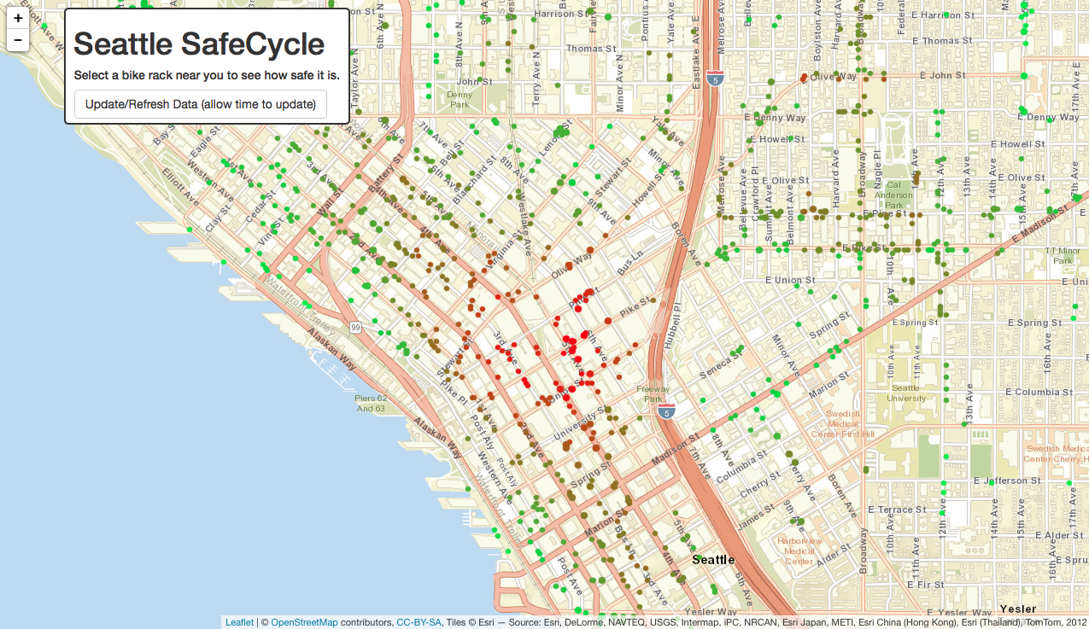

Slide 5
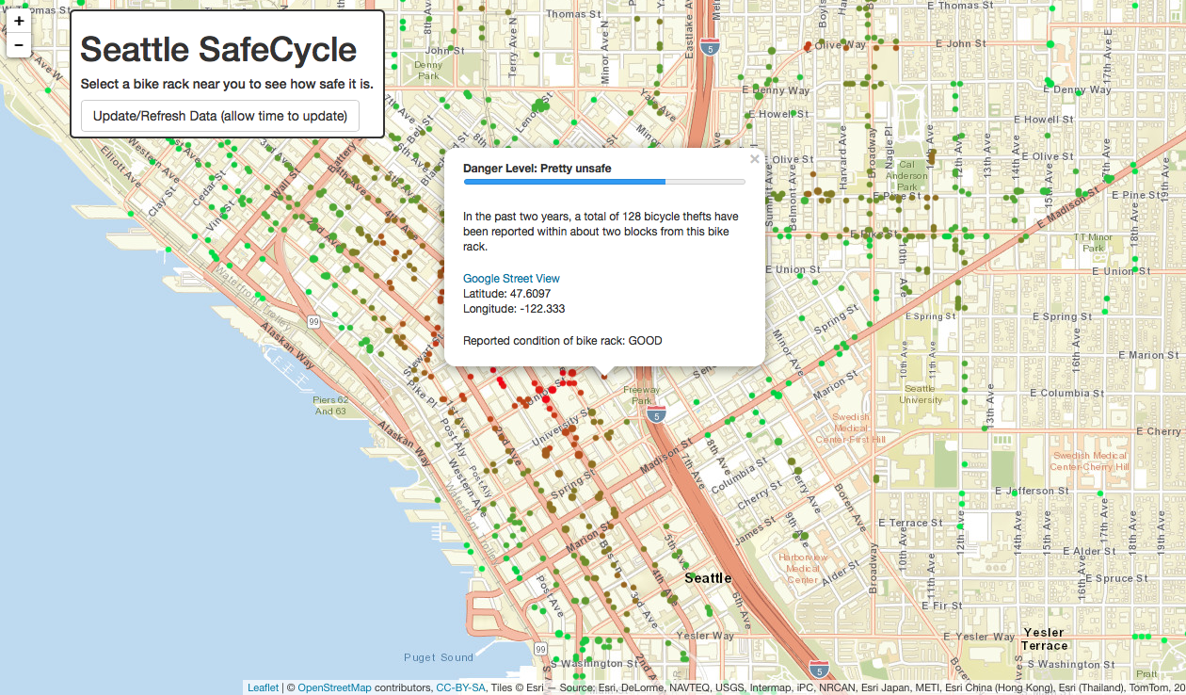

Slide 6
Ethical Concerns
potential danger is that certain individuals can use application to start looting bikes from safe area

Slide 7
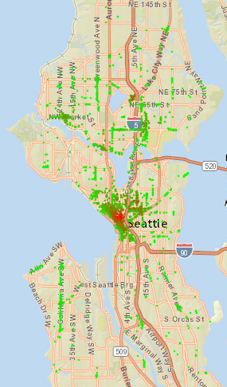
Analysis
near downtown Seattle (around the Westlake Link Station) is where bike thefts are most common
data implies that your bike has a more likely chance of being stolen in the areas with a stronger shade of red
least amount of thefts was 0 in areas far outside of downtown Seattle

Slide 8
Faults
higher population in downtown Seattle compared to an area outside of downtown, so naturally there will be a higher population of bikers, and as a result a higher amount of bike thefts.
The radius of calculation may be too large, and not representative of specific bike racks. Perhaps there may be a bike rack where there were no thefts but at a nearby bike rack the theft count is very high.

Slide 9
Major problems
Rendering the leafletOutput in ShinyUI
Loading of leaflet takes a very long time
Updating data button
Using JSON API from Seattle Department of Transportation
Rendering leafletOutput with 100vw was not working on different computers

Slide 10
Technical Description
Data wrangling
loadData.R
CSV files
assigned a safety rating
Server side processing
CSV file into a leaflet map
Creates functionality for updating data
Client side UI
add inline CSS to generated output
Generates UI
Libraries utilized
shiny,dplyr,leaflet for R,shinydashboard,graphics,googleVis, and shinyjs

